Slide 1
Capstone Project
GLOBAL TERRORISM
SUBMITTED BY :-
NISHA AHIRE

Slide 2
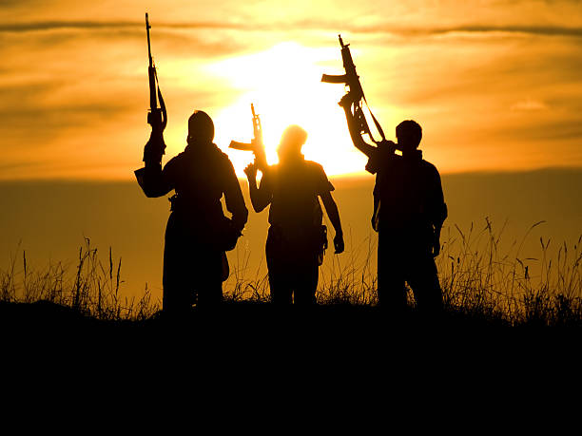
WORLD PEACE was one of the core reasons for forming the United Nations organization .Terrorism is the biggest hurdle to world peace. Terrorism is commonly ignored by the civilians who are not affected directly by the dangers. For the most part, terrorism is considered unpredictable and unfortunate calamity that strikes some parts of the world more than others. Based on the location of the events, people at large have very limited information about any such event happening in other parts of the world and hence react differently
In this project, we focus on terrorism by analyzing the dataset provided by START (Study of Terrorism and Response to Terrorism) Consortium to explore meaningful patterns and statistics.

Slide 3
INSIGHTS FROM THE GIVEN DATA
ATTRIBUTES | DESCRIPTION
Attacktype1_txt | The type of attack happened.
Target1_txt | Type of target involved in the attack
Success | ‘1’ if attack was a success. ‘0’ if attack was a failure.
Natlty1 | Nationality of attacker
Weaptype1 | Types of weapon used in attack
Nkill | Number of person killed in attack
Nwounded | Number of person wounded in attack

Slide 4
INSIGHTS FROM THE GIVEN DATA
ATTRIBUTES | DESCRIPTION
Longitude | Longitude of the location
Latitude | Latitude of the location
Property | Total property damaged happened in any event
Suicide | ‘1’ if attack was a suicide attempt. ‘0’ if attack was not a suicide attempt.
Motive | Motive of the attack
Age | Age of the attacker
Iday,iyear,imonth | Calendar of the attack

Slide 5
INTRODUCTION
Given dataset from the Global Terrorism Database have 135 columns,181691 rows and it is a mix of categorical and numeric values.And given database is incomplete, inconsistent, contains many errors, missing attributes values, contains outliers, incorrect tags, and duplicate entries, name of the columns are not informatory enough to develop proper understanding. so, we will rename the columns ,ie Data preprocessing and this can help us to resolve these discrepancies. and formation of informatory data so ,that we can extract the required columns for exploring and analyzing the database,to discover the key findings pertaining to terrorist activities.

Slide 6
QUESTION-1
FIND OUT NUMBER OF ACTIVE TERRORIST GROUPS WHICH ARE SPREADING THE THREAT OF TERRORISM ACROSS THE WORLD AND ALSO DETECT MOST ACTIVE ORGANISATION WHO HAS TAKEN RESPONSIBILITY OF ATTACKS.

Slide 7
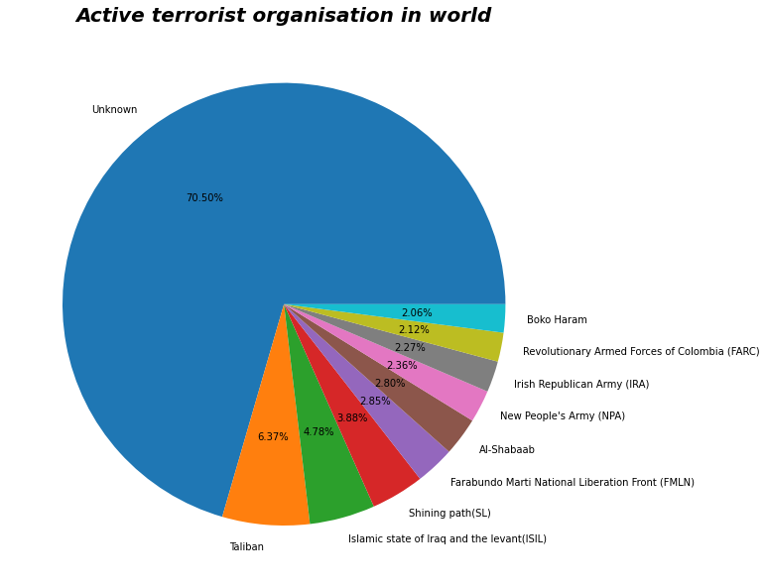

Slide 8
QUESTION -2
QUESTION NO.2-Find out the success rate of terrorist attacks and country ,city which is mostly targeted by the terrorist organisations

Slide 9
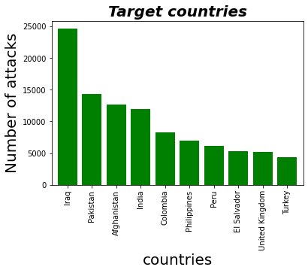

Slide 11
QUESTION-3
Finding out the pattern in the growth of number of attacks in following years

Slide 12
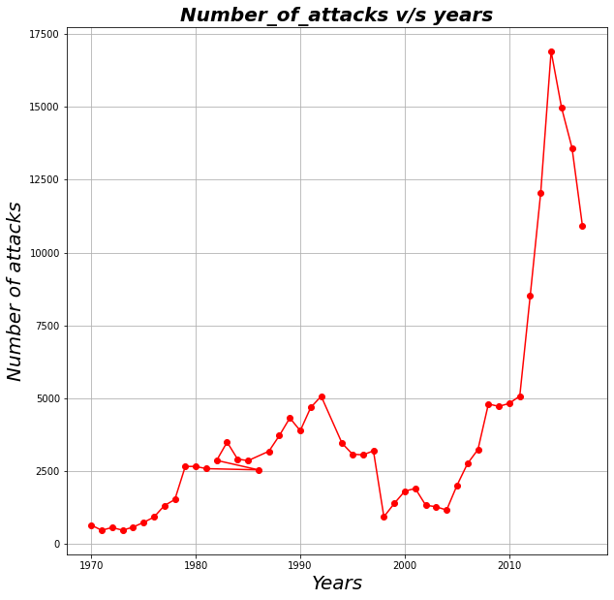

Slide 13
QUESTION-4
Hostile environment and global tension have increased because of the number of attacks in recentyears.so its very necessary to find out the weapons used behind this attack

Slide 14
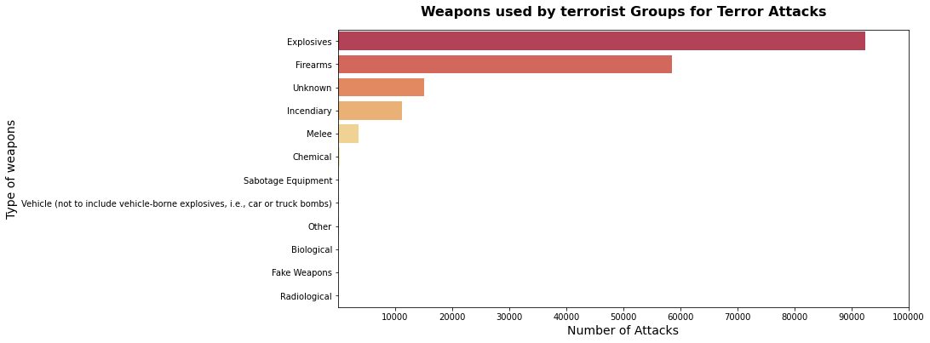

Slide 15
QUESTION-5
Find out the favourable attacking type ,used by terrorist to spread the antagonistic psychology of terrorism in the society.

Slide 16
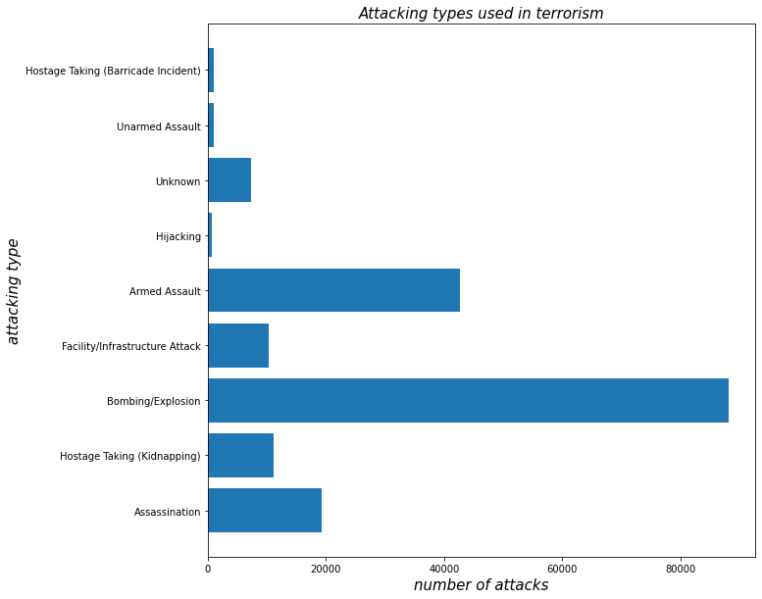

Slide 17
QUESTION-6
Find out the favourable targets of terrorist organisation ,and also estimate the harm caused by their attacks

Slide 18
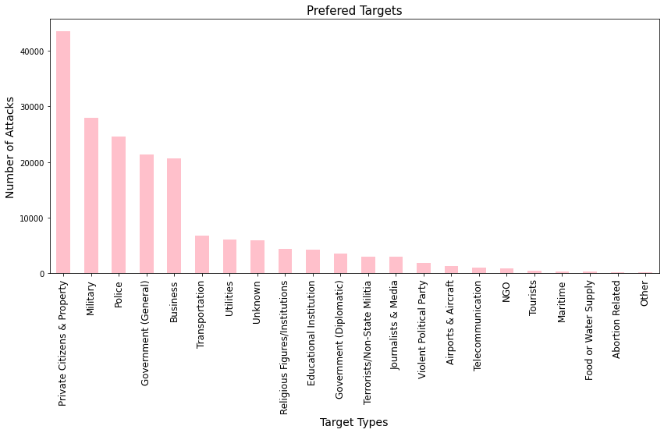

Slide 19
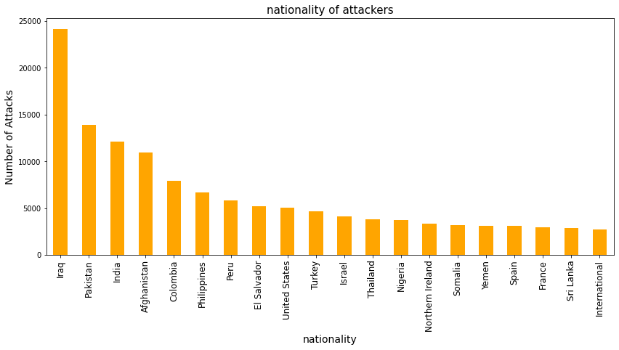

Slide 20
QUESTION-7
FINDING OUT THE TARGETS IN PARTICULAR CONTRIES.SO THAT WE CAN FOCUS MORE ON THE MOTIVE AND OBJECTIVE OF THE TERRORIST ATTACK ON THE COUNTRY.

Slide 21
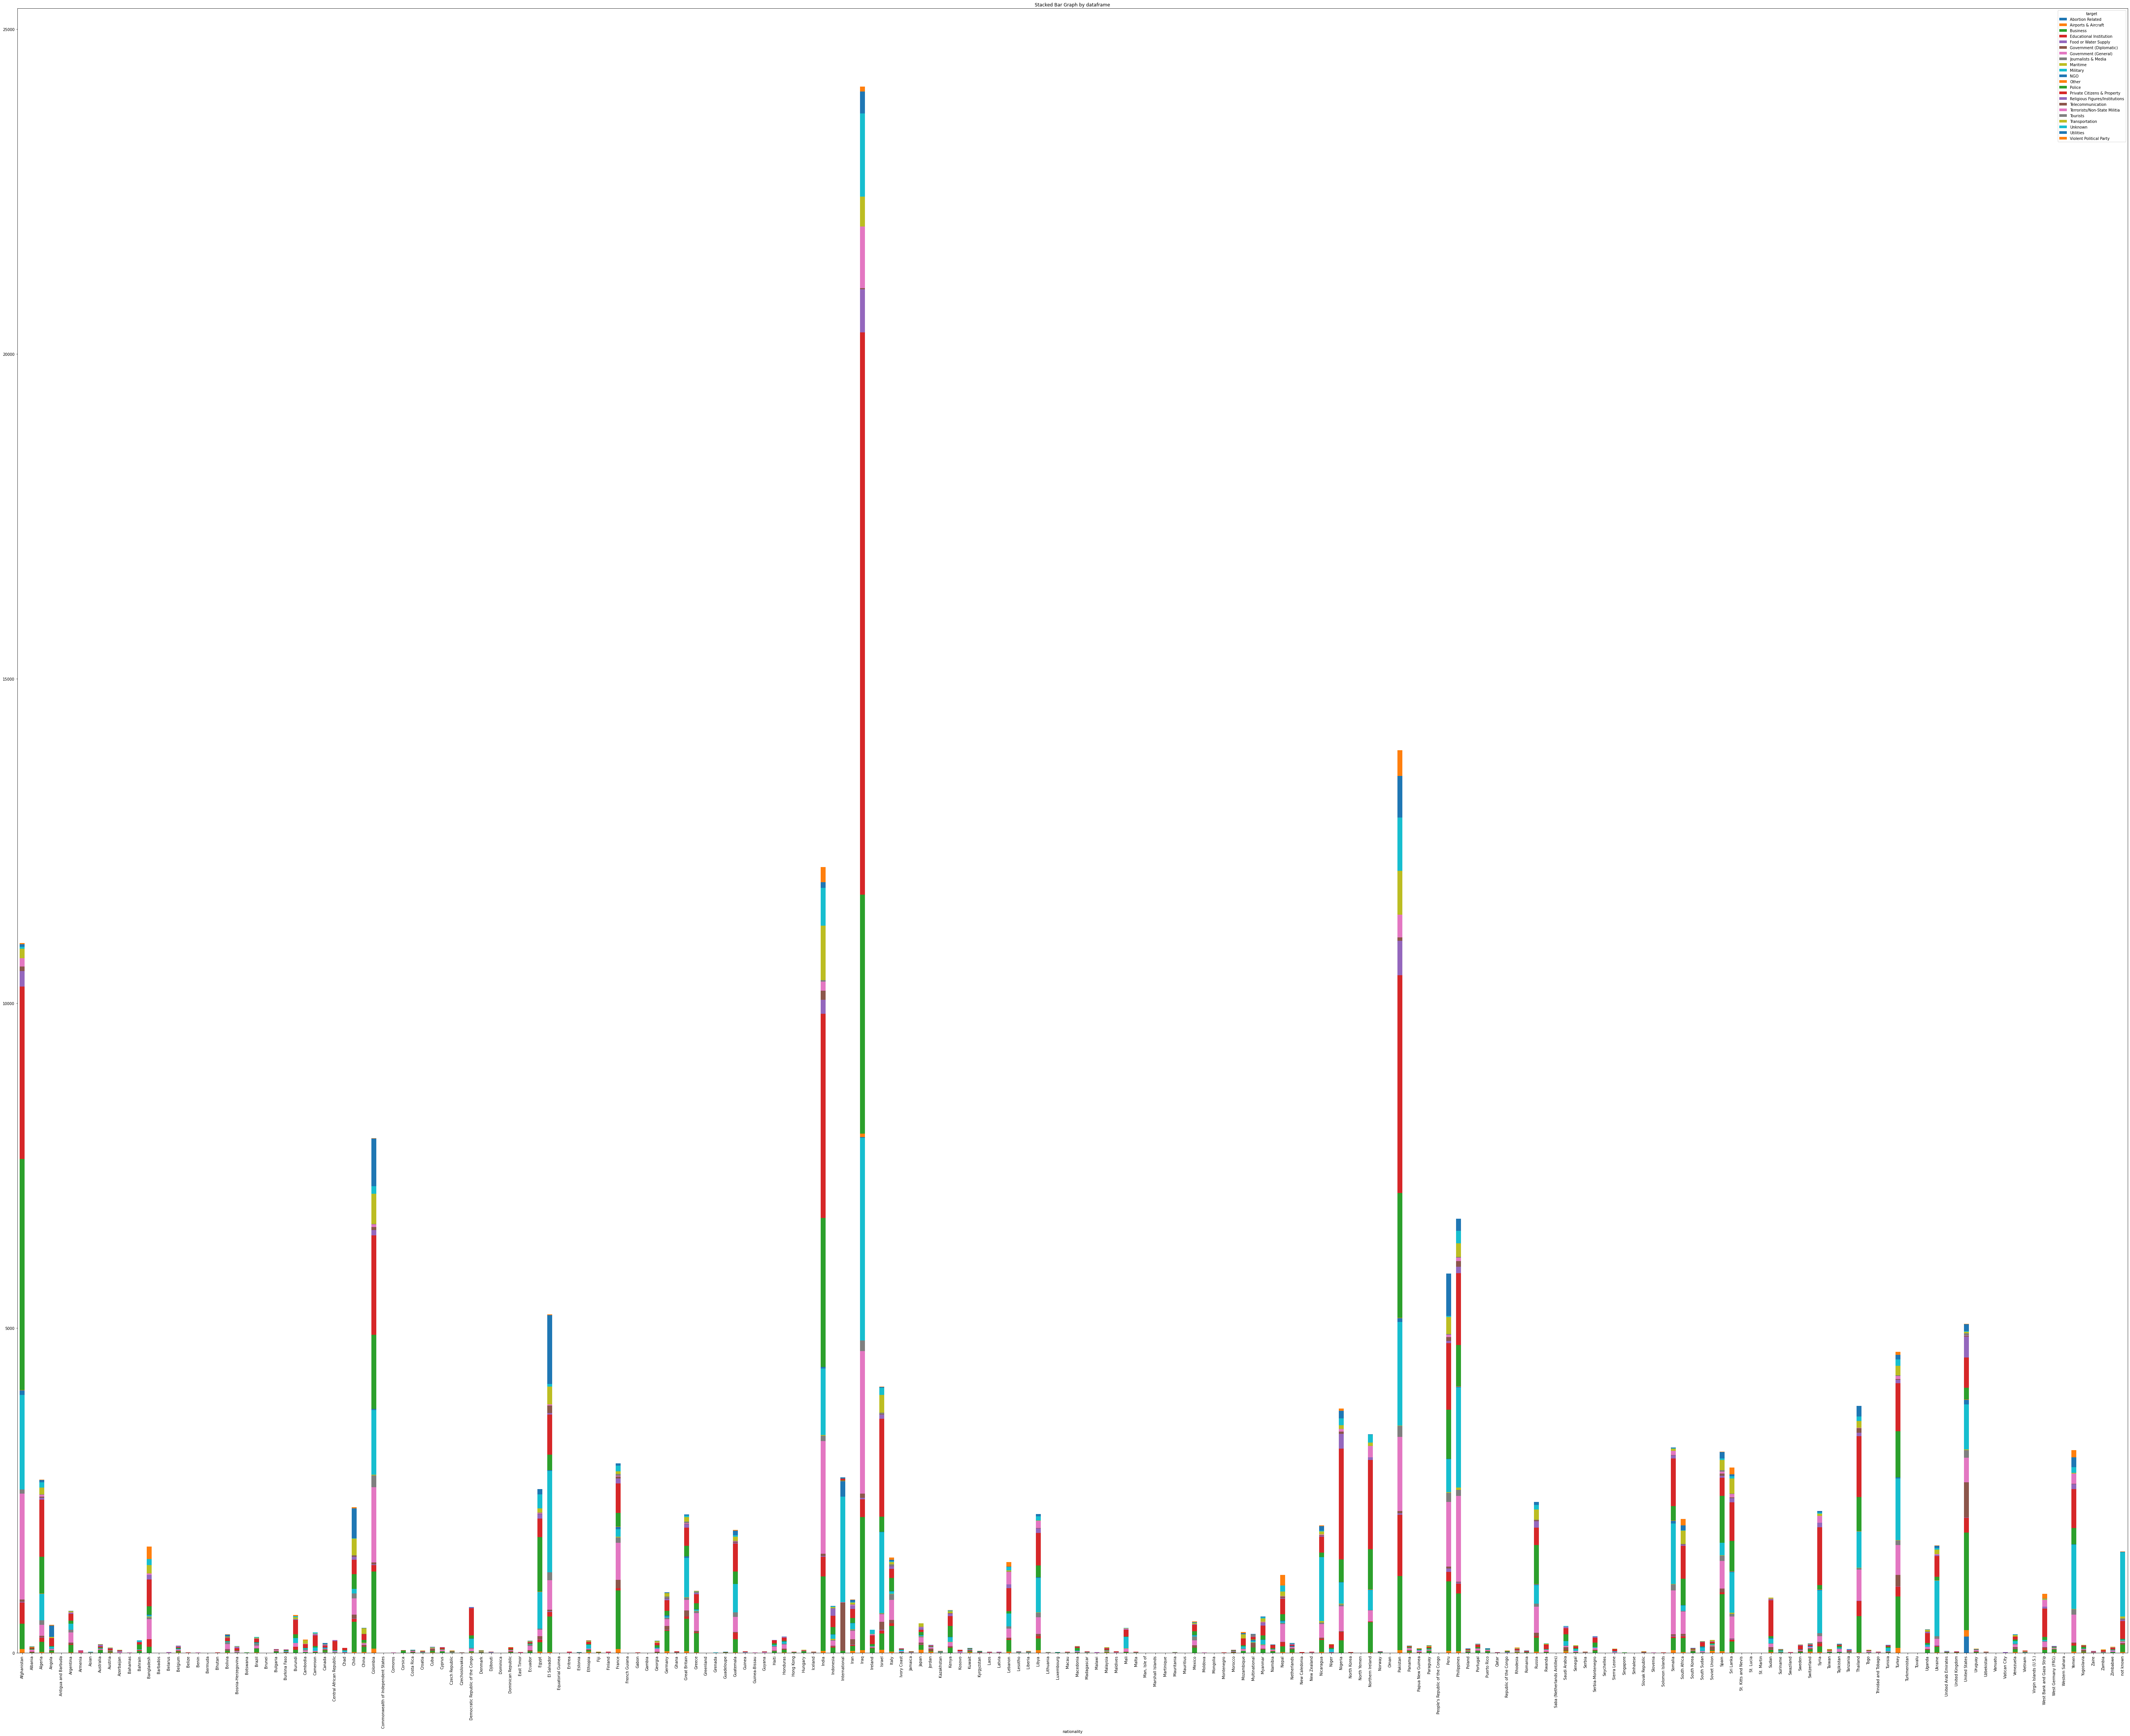

Slide 22
CONCLUSION
The goal of this project was to understand andinterpret the nature of terrorism.After doing the analysis we founded the following insights from the database
1. TALIBAN is the most active organisation who is taking responsibility of many of the attacks that had happened in the world.
2. IRAQ is the most affected by the attacks,so security groups should be extra cautious in this country.
3. IN 2014,maximum number of attacks has taken palce in the world,so it was the dark year of terrorism.
4 IT is seen from the database that the explosives were majorly used by theterrorist groups for the attacks.so security groups should try to locate the their sources from where they acquire this explosives.
5 After doing the analysis we founded that that citizens are the major targets of the terrorist group ,and the noticable part is that IRAQ is most affected by the terrorist groups,and maximum number of member of terrorist group belong to the nationality of IRAQ.

